Slide 1
TOPSI 2.0
The future of SOK Stores and Chains applications
Capgemini
xx^{th} August 2015

Slide 2
Why this approach?
Application lifecycle management
One cross functional team
Critical success factors
Analyst voice and references

Slide 3
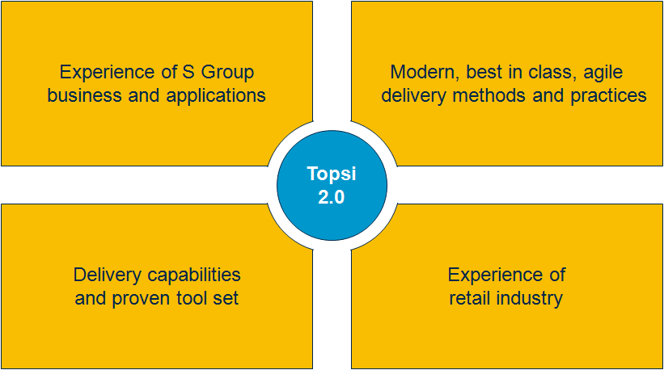
We have prepared this solution based on our proven delivery capabilities and experience of S Group business
We have created a concrete vision of the Topsi future state application management solution.
Our approach and solution is built on:
Our wide experience of S Group business and applications
Our deep understanding of modern, best in class, agile application development, application management and application operations delivery methods and practices
Our delivery capabilities and proven tool set
Our experiences of similar services in retail industry
Onko referenssejä?

Slide 4
Our vision is to integrate development, operation, testing and infrastructure into one agile end-to-end pipeline
Our solution removes the silos between application development and application operations thus bringing true agility to the whole pipeline end-to-end.
Business
Development
Testing
Operations
Topsi 2.0 Application Lifecycle
Continuous Integration – Continuous Delivery – Continuous Deployment
Agile Development – Automated Testing – Scalable Infrastructure

Slide 5
Today waste is generated in many areas but it can be removed radically
Current ways of working
Manual Work (lisätään lukuja??) Deployments require human intervention and actions We must rely on release and environment specific installation instructions and scripts Environment configuration is done on an “as-needed” basis
Long Wait Times Throughout The Pipeline Teams waiting on manual handoffs Delayed time-to-test Insufficient notification
Unproductive Work and Inefficient Use of Environments Deploying things that have not changed Deploying same things several times in many environments Using static environments, not leveraging virtualization & cloud Managing infrastructure & apps separately
Poor Visibility Outside the Silos Reliance on release notes, spreadsheets, distribution lists, and high number of status meetings and calls Limited understanding of deployment dependencies and status Long or too many outage windows
Required changes
Removing Activities Requiring Manual Work Automated deployments Graphical process designer Environment configuration managed as part of deployment (scalable infrastructure)
Eliminating Long Wait Time Bottlenecks Automated notifications Include provisioning as part of deployment Add automated testing to deployment process
Reducing Root Causes of Unproductive Work Only deploy what has changed Leverage production-like environments e.g. in testing Get the most out of virtualization & cloud Manage infrastructure & applications together
Raising Visibility by Removing the Silos and Setting Up One Team Known status of resources at-a-glance Immediate view of deployment compliance Status, feedback & understanding of all parts of deployment as it occurs

Slide 6
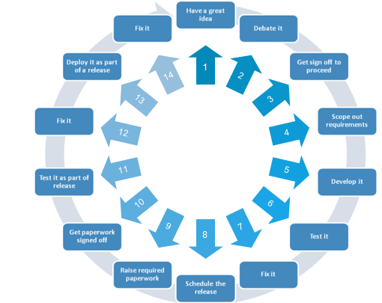
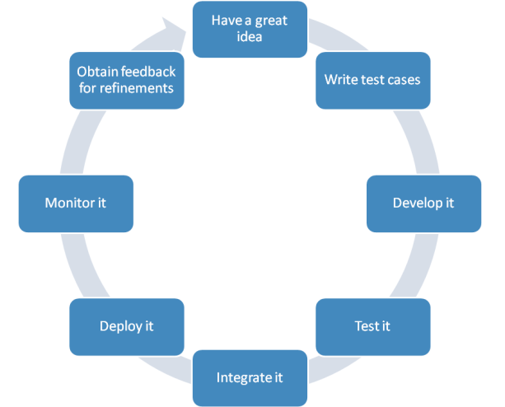
The objective is to simplify and streamline the application lifecycle management from development to operations
1
2
3
4
5
6
7
8

Slide 7
Our solution brings several benefits in terms of improved quality…
Benefits
Improved Quality
Easy and faster access to new features and business functionalities: capability to meet the constantly changing business requirements
Higher end-to-end availability and successful days at business processes due to:
Less disruptive upgrades
Less hand-overs within release deployments
Automated provisioning
Automated testing
Automated deployments
Better change management in the whole environment
Improved security.
Flexibility and Agility
Lower Lifecycle Costs

Slide 8
… increased flexibility and agility throughout the pipeline…
Benefits
Improved Quality
Faster time-to-market of solutions that meet changing business needs due to:
Built-in flexibility when moving from Waterfall IT to Agile IT
Acceptance of changes in smaller, granular and manageable portions
Shorter development-to-production lifecycle
Increased automation level in
Continuous integration
Testing
Continuous deployment
Infrastructure provisioning
Improved capability to cope with changes in application landscape and support introduction of new technologies:
Our agile pipeline model supports SATO transitions
Our model is not applicable only to current application landscape but can also be applied to SATO
Flexibility and Agility
Lower Lifecycle Costs

Slide 9
…and remarkable overall cost savings
Benefits
Improved Quality
Significantly lower development costs due to
Simplified and agile sw-development process (e.g. case Fosteri)
Efficient use of offshore also in development
Less manual work in all phases due to increased automation
Lower infrastructure costs due to dynamic, scalable capacity and resource scaling
Lower license costs due to use of SaaS and Open-Source Software tools
Less effort spent on wasteful deliveries due to stable and predictable releases.
Flexibility and Agility
Lower Lifecycle Costs

Slide 10
Why this approach?
Application lifecycle management
One cross functional team
Critical success factors
Analyst voice and references

Slide 11
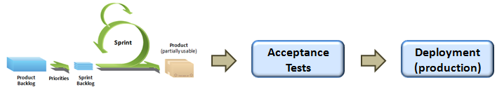


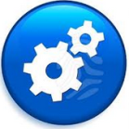
We will create one continuous deployment pipeline
570 deployments in 2014!
Now
Development
Release pack
Release pack
Testing
Operations
Release pack
Release pack
Release pack
Deployment
pipeline
Testing
Operations

Slide 12

Capgemini continuous deployment pipeline
Delivery Orchestration
Continuous Integration
Dynamic Capacity
Agile Development
Continuous
Delivery
Automated testing
DEV
TEST
Application Performance Monitoring
PROD
Continuous feedback loop

Slide 13
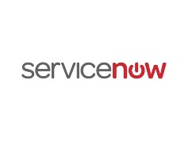
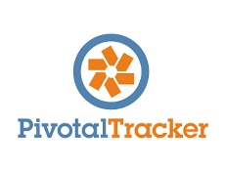
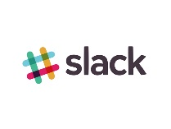
Agile Development
Agile software development is a group of software development methods in which requirements and solutions evolve through collaboration between self-organizing, cross-functional teams. It promotes adaptive planning, evolutionary development, early delivery, continuous improvement, and encourages rapid and flexible response to change.
Purpose
Capgemini method
To be able to reap the benefits of Agile ways of working a close co-operation between developers and client is required. A spokesperson on each side is required, on the client side that role is called Product Owner and on the development team side the role is SCRUM Master. Together these two collaborate on the product (software) roadmap using contexts like stories and epics. Methods used include daily stand-up meetings and weekly meetings enabling quick responses for changing business needs. These methods were used together with SOK Chains and Stores people in Fosteri project with great success.
Capgemini tools:

Slide 14
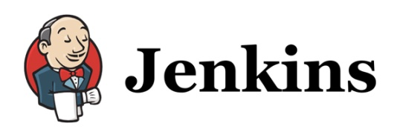
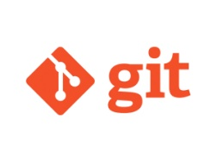
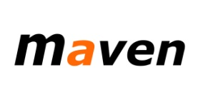


Continuous Integration
Continuous Integration (CI) is a development practice that requires developers to integrate code into a shared repository several times a day. The code is automatically validated and code that does not compile cannot be committed. By using CI teams can detect problems immediately and the time used for problem solving is decreased.
Purpose
Developer commits the code to central repository that is accessible also over cloud
Check-in is verified by an automated build
Run Code analysis tools to perform static code analysis
Create the binaries (war, ear) for deployments on to the Application Servers including packaging the different modules/applications
Capgemini method
CI Server: Jenkins
Build: Maven
Configuration Management/Repository: Git for version control, Nexus as component repository
Code static analysis: SonarQube, CAST
Capgemini tools:

Slide 15
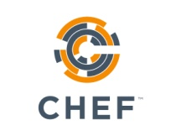
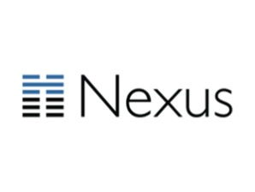
Continuous Delivery
Purpose
Continuous Delivery (CD) automates and improves the process of software delivery. It provides the ability to rapidly, reliably and repeatedly push out enhancements and bug fixes to customers at low risk and with minimal manual overhead.
Capgemini method
Continuous Delivery manages, plans and controls the storage of binaries used for deployments relying on the software release cycles.
It controls the flow of binary artifacts from development to production environment.
Sonatype Nexus as component and application repository
Deploy: Chef
Configuration Management/Repository: Git for version control, Nexus as component repository
Capgemini tools:

Slide 16
Test automation and security
Test automation is the use of special software to control the execution of tests and the comparison of actual outcomes with predicted outcomes. Service Virtualization captures and simulates the behavior, data and performance characteristics of complete composite application environments, making them available for development and test teams throughout the software lifecycle. These together enable early detection of functional errors and gives immediate feedback to developers. Faster Time-to-market by reduced testicg cycle time.
Purpose
Capgemini method
Test case creation to automation suite
Capture of behavior, data and performance characteristics of complete application environments
Automatic tests are executed continuously throughout development
Capgemini tools:
Automation Templates Toolkits
Capgemini Automation Framework (CAFÉ)
X-Tester
QTP utilities
Rebot Framework

Slide 17
Capgemini Dynamic Infrastructure
Dynamic infrastructure enables agile and automated infrastructure management and provisioning of development, test and production environments. It lowers costs with pay-as-you-go model and increases quality, reliability and visibility of infrastructure.
Purpose
Capgemini method
Dynamic Capacity with horizontal & vertical scalability
Vertical - scaling a single node (CPU/Memory/Disk)
Horizontal - scaling the amount of nodes; best fit for distributed and stateless cloud-ready applications
Automated provisioning via self service portal, e.g:
Service requests: launch a VM, modify and terminate
Control VMs: start, stop, restart and hibernate
Fast, versatile and standard delivery
On-demand, pre-established infrastructure
Immediate value creation
Elimination of foundation tasks
Exceptionally high security standards
System residues in high-secure infrastructure
Two-phased strong authentication for all users of Cloud portal
All processes related to infrastructure comply with our high security (governmental) customer processes
Capgemini tools:
Capgemini Nordic Cloud

Slide 18
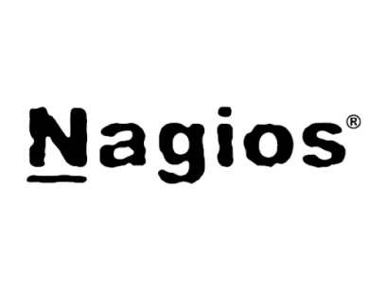
Application Performance Monitoring (APM)
Application Performance Management (APM) is responsible for monitoring and managing the performance and availability of software applications. In addition to real-time monitoring it prevents problems from occurring by detecting early warning signs of issues and can also help automatically resolve some performance and quality issues.
Purpose
APM tools alert IT staff to disruptions in availability and/or quality
It enables feedback loop for the team
Monitor IT infrastructure
Detect security breaches, Plan & budget for IT upgrades
Automatically collects normal metrics for normal application performance and compares those to the current state in real time
Capgemini method
AppDynamics for application performance monitoring
Nagios as generic monitoring tool
Piwik for user profiling and behavious analysis
LogStash for Log analysis
Capgemini tools:

Slide 19

Delivery orchestration
Purpose
The purpose of the delivery orchestration is to manage the application life cycle across teams and environments end to end from the requirement identification to the ongoing production support including application, infra and tools.
Delivery orchestration uses automated tool, which automatically remediate the majority of event alerts on a daily basis for IT operations. Based upon the type of alert, the orchestration environment automatically takes the steps necessary to identify and diagnose the problem.
Capgemini methods
Managing the lifecycle of changes:
Ensuring that changes are monitored, tracked and controlled from initial logging through to the production environment,
Ensuring that all Changes are authorized by the required Change Authorizers
Ensuring that changes are prioritized by the Client and managing back log
Liaising, throughout the life cycle of a change, with Support Groups, Third Party Suppliers and Client
Coordinating Change handlers and ensuring that agreed changes are delivered on-time and on agreed scope.
Maintaining release plan and coordinating deployments and releases
Runs daily stand-up meetings and weekly operation meetings.
Coordinating production support for application (monitoring and resolution)
Routine tasks and ad hoc activities
Configuration management
Project management
Continuous improvement of processes and procedures based on requirements from SOK, incidents and defects, other feedback
Capgemini tools:
ServiceNow
TeamForge
Virtual Visual Management
AppDynamics, Confluence

Slide 20
Why this approach?
Application lifecycle management
One cross functional team
Critical success factors
Analyst voice and references

Slide 21
One cross-functional team is responsible for the application product end-to-end
One team across borders despite the location or organization
Traditional silos are destroyed and everybody has access to same dashboards and tools
Multi-skilled teams enable efficient work flow
Instead of each team focusing separately either on coding, testing or deploying everybody focuses on the product itself and strives for common goal
New approach improves efficiency and knowledge sharing
It tightly integrates business, development and operations to drive agility and delivery excellence across the entire lifecycle
Notes:
siloed teams, each with differing motivations and areas of focus doesn’t deliver consistency.
Common goals, tools and processes
Team is empowered to self-sufficient as they can code, test and deploy

Slide 22
Certain roles are vital for successful implementation of agile methods throughout application lifecycle
Release Manager oversees coordination and integration of development, testing and deployment tasks to support continuous delivery
Automation Architect analyze, design, and implement automation strategies
Experience Assurance Professional ensures that all new features and functions are released with intended end user experience
Product Owner is responsible for the product success and value creation
Technical specialists takes care of both development and operational tasks and testing
Service Delivery Manager is
contact point for contractual terms
Orchestration Lead
coordinates all work from development to production and has end to end responsibility for ensuring continuous flow of value for the business. Orchestration Lead works as SCRUM Master.
Utility Professional operates across development platforms, tools, networks, servers and databases to ensure quality and resource management are taken care of
Security Engineer works side by side with developers to ensure security issues are taken into account early in the process
Service Virtualization Architect defines and designs service virtualization

Slide 23
Why this approach?
Application lifecycle management
One cross functional team
Critical success factors
Analyst voice and references

Slide 24
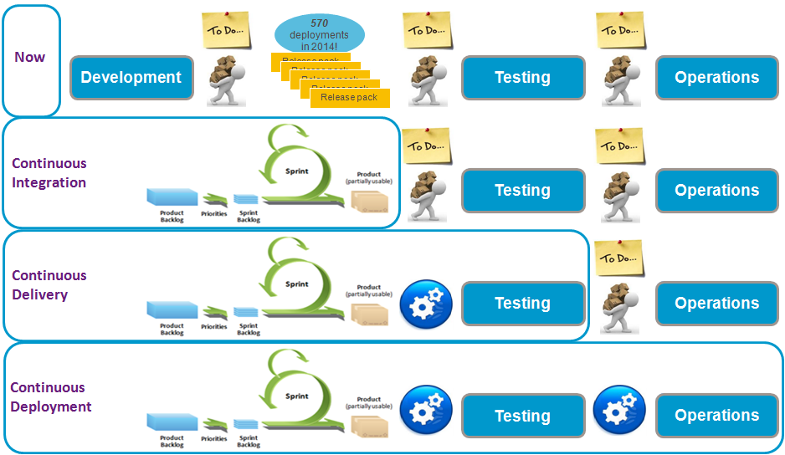
The transformation from silos to one application lifecycle management pipeline requires major changes
The seven critical success factors of a successful DevOps transformation:
SaaS tools
for testing and monitoring:
”I pay for what I use”
APM*:
”I want full visibility to applications and a way to do preventive maintenance”
Dynamic Infrastructre:
”I need one production like environment for testing for two days”
Static Code Analysis:
”I want that every piece of software entering the pipleline is bug-free”
Automated Testing:
”I want better application quality and availability with less manual work”
Built-in Automated Security Testing:
”Because I can’t afford any security breaches”
One integrated team of Capgemini and SOK professionals working together every day:
”Because there is no us and them – the whole principle of DevOps is built on One Team approach where One Team is responsible for the applications end-to-end: from the business requirements to the implemented features in production”
*Application Performance Monitoring

Slide 25
Why this approach?
Application lifecycle management
One cross functional team
Critical success factors
Analyst voice and references

Slide 26
Benefits of DevOps have been verified by several research companies
Heli
High-performing IT organizations deploy 30x more frequently with 200x shorter lead times;
they have 60x fewer failures and recover 168x faster.
Lean management and continuous delivery practices create the conditions for delivering value faster, sustainably.
High performance is achievable whether your apps are greenfield, brownfield or legacy.
IT managers play a critical role in any DevOps transformation.
Diversity matters.
Deployment pain can tell you a lot about your IT performance.
Burnout can be prevented, and DevOps can help.
Source: Puppet Labs; 2015 State of DevOps Report

Slide 27
Organizations who are employing DevOps practices are out-performing even the fastest high performers
In 2007 Visible Ops survey the high-performing IT organizations were:
5-7x times more productive
making 14x more changes, with
one-half the change failure rate
4x higher first fix rates,
10x shorter Severity 1 outages times.
4x fewer repeat audit findings
5x more likely to detect breaches by an automated internal control,
8x better project due date performance!
Organizations who are employing DevOps practices are out-performing our fastest high performer by orders of magnitude
Amazon has gone on record stating that they’re doing over 1,000 deploys a day, sustaining a change success rate of 99.999%!
Heli
Source: IT Process Institute, IT revolution press; Top 11 Things You Need To Know About DevOps

Slide 28
With DevOps approach the quality is not sacrificed to deliver fast
Development teams that consistently deliver at the fastest cycle times enjoy the highest business satisfaction.
Incremental improvements to waterfall methods run out of steam at one- to two-month delivery cycles.
Eight DevOps/continuous delivery practices are the key.
Deliver small increments of functionality;
Use dedicated, cross-functional teams;
Use loose architectural coupling;
Automate environment provisioning;
Continuously integrate code;
Continuously test;
Continuously fund; and
Provide real-time transparency.
DevOps practices address the top reasons for project disappointment.
DevOps practices reduce cycle time and the risk of failure at the same time.
Heli
Source: Forrester Consulting, The New Software Imperative: Fast Delivery With Quality, October 2014.

Slide 29
DevOps Organizational Adoption should be started Before It Becomes a Burning Issue
Heli
70% of IT organizations that do not adjust their organizational structures as part of their DevOps adoption plans will fail to achieve the desired results from their DevOps implementation.
Static hierarchical structures typically do not offer the flexibility or responsiveness required.
A virtual team, as opposed to solid-line reporting.
One key factor is ownership of the overall team result.
The customer is part of the team.
Having the voice of the customer within the team can reinforce the overall goal and further aid in bridging the gap between applications and operations.
Source: Gartner; Organize the Right Teams for Successful DevOps, 27.9.2012

Slide 30
Worldwide cost of IT failure (revisited): $3 trillion
For just the Standard & Poor 500 companies, aggregate 2012 revenue is estimated to be $10 trillion.
If 5 percent of aggregate revenue is spent on IT, and conservatively, 20 percent of that spending creates no value for the end customer - that is $100 billion of waste!
Heli
Vähän liika höttöä on lähde
Source: http://www.zdnet.com/article/worldwide-cost-of-it-failure-revisited-3-trillion/

Slide 31
Benefits of DevOps are real and measurable
Heli
20 percent improvement in time-to-market,
22 percent improvement in software quality,
17 percent improvement in frequency of application deployments
22 percent more customers
19 percent increase in revenue
Source: TechInsights Report: What Smart Businesses Know About DevOps, September 2013

Slide 32
This is not only theoretical approach, this is real life
In Capgemini we have reached the following improvement with this approach:
50% faster solution deployment time
96% faster creation of new environment
20% reduction in FTEs
Significant improvement on availability (from <99,4% to >99,6%)
Example from one of our clients
Heli

Slide 33
Case Thales
Seetesh

Slide 34
Capgemini has wide experience in agile application lifecycle management
Seetesh
Include Philips reference list
Picture of logos

Slide 36
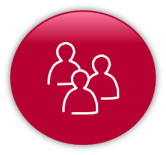

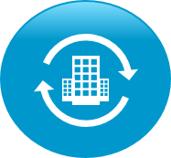
Today ”DevOps” is a widely used buzzword, but we know how to exploit the DevOps principles in real life
Raskas
DevOps… Saiko sitä sanaa käyttää
What the industry says
What we say and do with our clients
Wikipedia
A software development method that stresses communication, collaboration and integration between software developers and information technology professionals
http://en.wikipedia.org/wiki/DevOps
DevOps is a way of collaborating and industrializing using highly automated approaches to deploy solutions that evolve as fast as your business needs it
Techopedia
A “project management” philosophy: “The term DevOps is commonly considered a combination of the concepts of Development and Operations. It is used in IT to refer to roles or processes that bridge various departments – usually Development and Operations teams – to achieve a certain project management philosophy that involves more efficiency in communications between Development teams and other parts of a greater business or organization.”
EMA
Analysts
The ideal intersection of people, processes, and tools across the application lifecycle, facilitating the seamless delivery of software to the business
By adopting DevOps an organization can dramatically improve the value delivered by its business.
Gartner
A philosophy to improve collaboration between operations and development teams; better utilize technology, especially automation tools
http://www.gartner.com/it-glossary/devops
IBM
Transforming software delivery for enterprise innovation with real business outcomes
http://www.ibm.com/ibm/devops/us/en/
The team centric DevOps ethos tears down traditional silos to tightly integrate business, development and operations to drive agility and service delivery excellence across the entire lifecycle.
TCS
It is an Agile-based approach to integrating operations personnel with development personnel during the software development cycle to ensure that the software is operable and supportable in the production environment as and when the software needs to be released
http://www.tcs.com/resources/white_papers/Pages/DevOps-software-development.aspx

Slide 37
Success criteria of the solution include one cross-functional team, agile methods throughout the pipeline and high rate of automation
One team
No silos between
Dev, Ops, Infra
and Testing
Agility
Build-Release- Run-Repeat
Automation
Automated testing and integrated toolsets
Means: Combined AD/AM/IS team that takes care of all SOK Kemy systems
Means: Agile development and continuous deployment combined with dynamic capacity
Means: Automation everywhere supported by PaaS, IaaS and Best of Breed solution

Slide 38


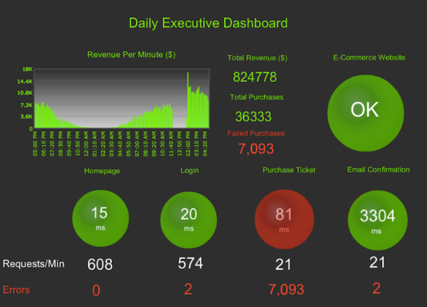
The application lifecycle from business to operations
Minna
Cost Saving
Minimum viable product
Right time
Rapid time to value
Business Development Testing Operations
From silos to one pipeline

Slide 39
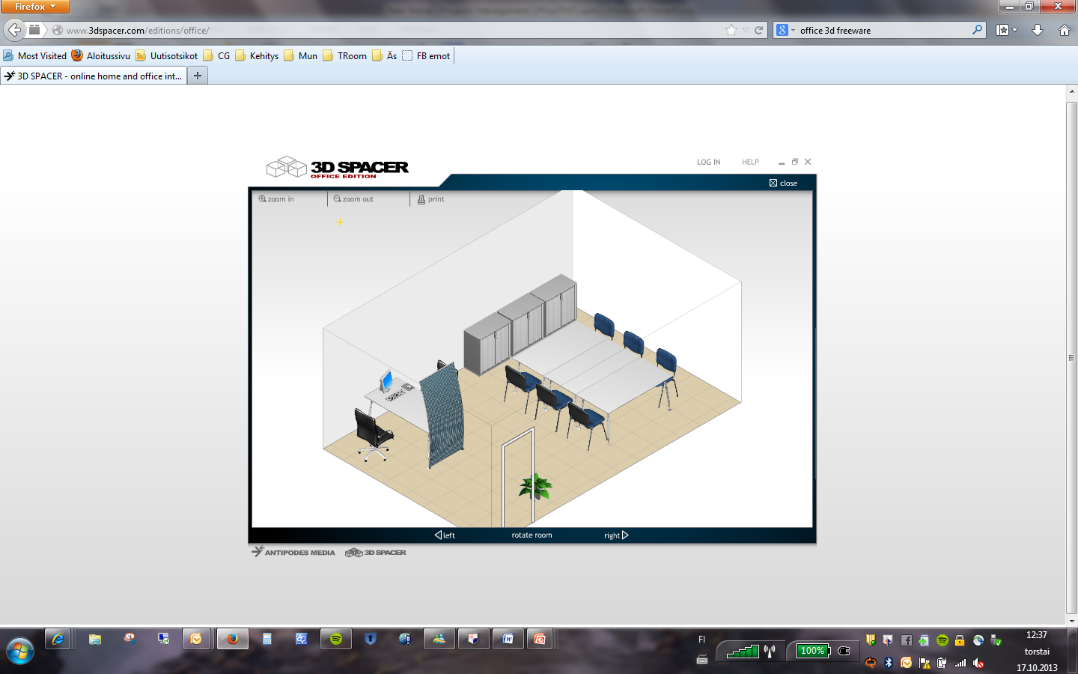
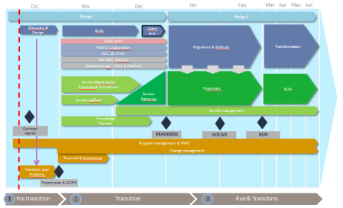


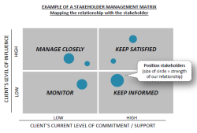
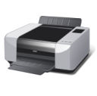
One team works efficiently cross border using war room
Jostain parempi kuva tai pois
HIGH
Impact
LOW
LOW
Likelihood
HIGH

Slide 40
Capgemini continuous deployment pipeline
Real-time application performance monitoring
Automated testing and security
Development
/System testing environment
Acceptance testing environment
Production environment
Continuous feedback
Remote server automation and virtualization (Dynamic capacity)
Continuous Delivery
Continuous Integration
Agile Development
Delivery Orchestration

Slide 41




Capgemini Continuous Deployment pipeline
Delivery Orchestration
Continuous Integration
Agile Development
Dynamic Capacity
Continuous
Delivery
Automated testing
DEV
TEST
Application Performance Monitoring
PROD
Continuous feedback loop

Slide 42

Delivery Orchestration
Agile Development
Dynamic Capacity
Continuous
Delivery
Automated testing
DEV
Application Performance Monitoring
Continuous
Integration
TEST
PROD

